Slide 1


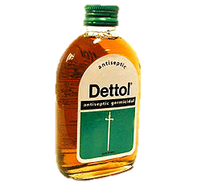
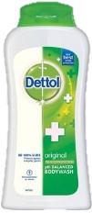

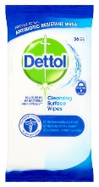

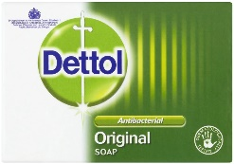
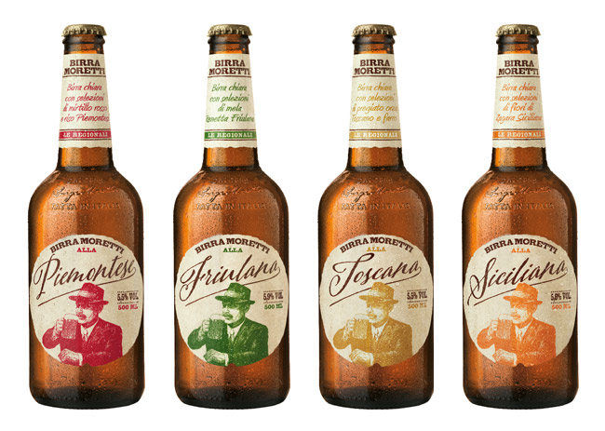
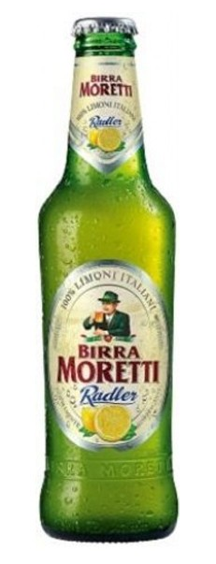
LEAD & EXPAND
Case studies How to learn from successful brands in similar situations
LEAD
EXPAND
As a leading brand you need to expand category boundaries
Innovation: Re-define the universe in which you compete
Antiseptic for cuts/grazes - 1930’s
Antiseptic for skin - 1980’s
Bodywash
Surface cleanser
Cleaning wipes
Washing Machine Cleaner - 2015
Dettol has constantly reframed their business boundaries through a series of innovations into immediately adjacent and non-adjacent categories. Only a very small portion of their sales now down to their original core product (0.13% of total sales).
Assortment: Cover all category needs
Incremental innovation – 50% increase in assortment width through ranges targeted at new buyers
Moretti has taken over as the number 1 beer in Italy by identifying partitions in the market in which they were not playing. Moretti then entered these partitions through a series of regional beers and a Raddler. Attracting buyers who didn’t previously purchase Moretti

Slide 2

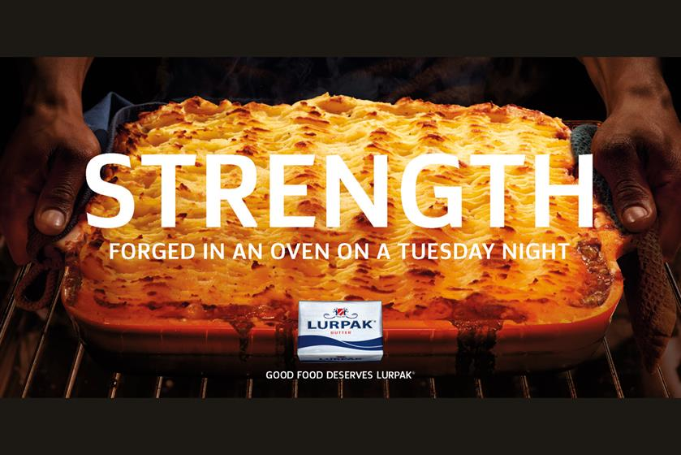

LEAD & EXPAND
Case studies How to learn from successful brands in similar situations
LEAD
EXPAND
As a leading brand you need to expand category boundaries
Attitudes: Strengthen meaning and relevance
Simple has done a great job of building relevance towards a emerging category need. Consumers were looking for more natural products free from chemicals and fragrances
Advertising: Reinforce at scale
Lurpak is the category leader in spreads and had focused its advertising on increasing category usage by encouraging scratch cooking and multiple food occasions.

